Slide 1
saqarTvelos parlamenti
Tbilisi
23. XII. 2010 w.

Slide 2
Jgufis 1 Tvis angariSi
I. konferencia-03.XII.2010-Tssu(gaSuqda presaSi da televiziis axal ambebSi)
II. Sexvedra 17.XII.2010.parlamentis ganaTlebisa da mecnierebis komitetetSi
III. aqtiuri monawileoba 16.XII.2010
bavSvis zrdisa da ganviTarebis piradi baraTis(0-dan 6wlamde asakis bavSvebisaTvos) prezentaciaze
. IV. Sedvedra 21.XII.2010-Telavis b/s administraciasTan

Slide 3
3-4 dekemberi, Tssu Tbilisi
2010
3-4 December, TSMU Tbilisi

Slide 4
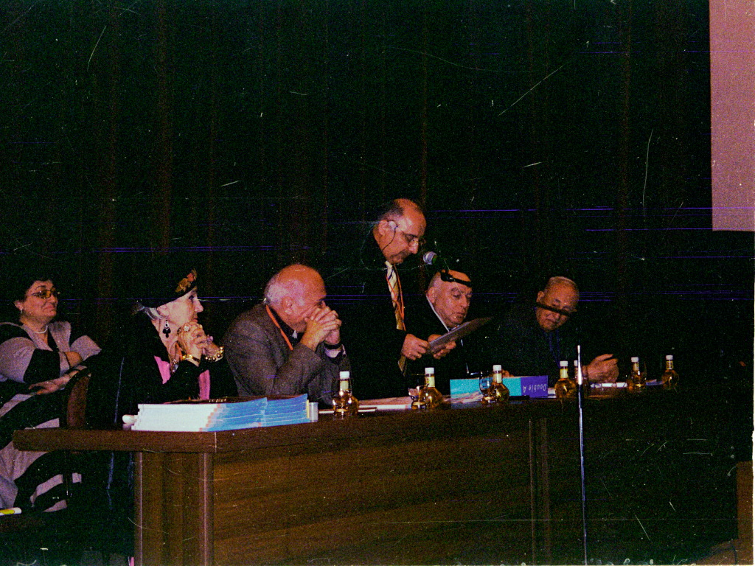

Slide 5
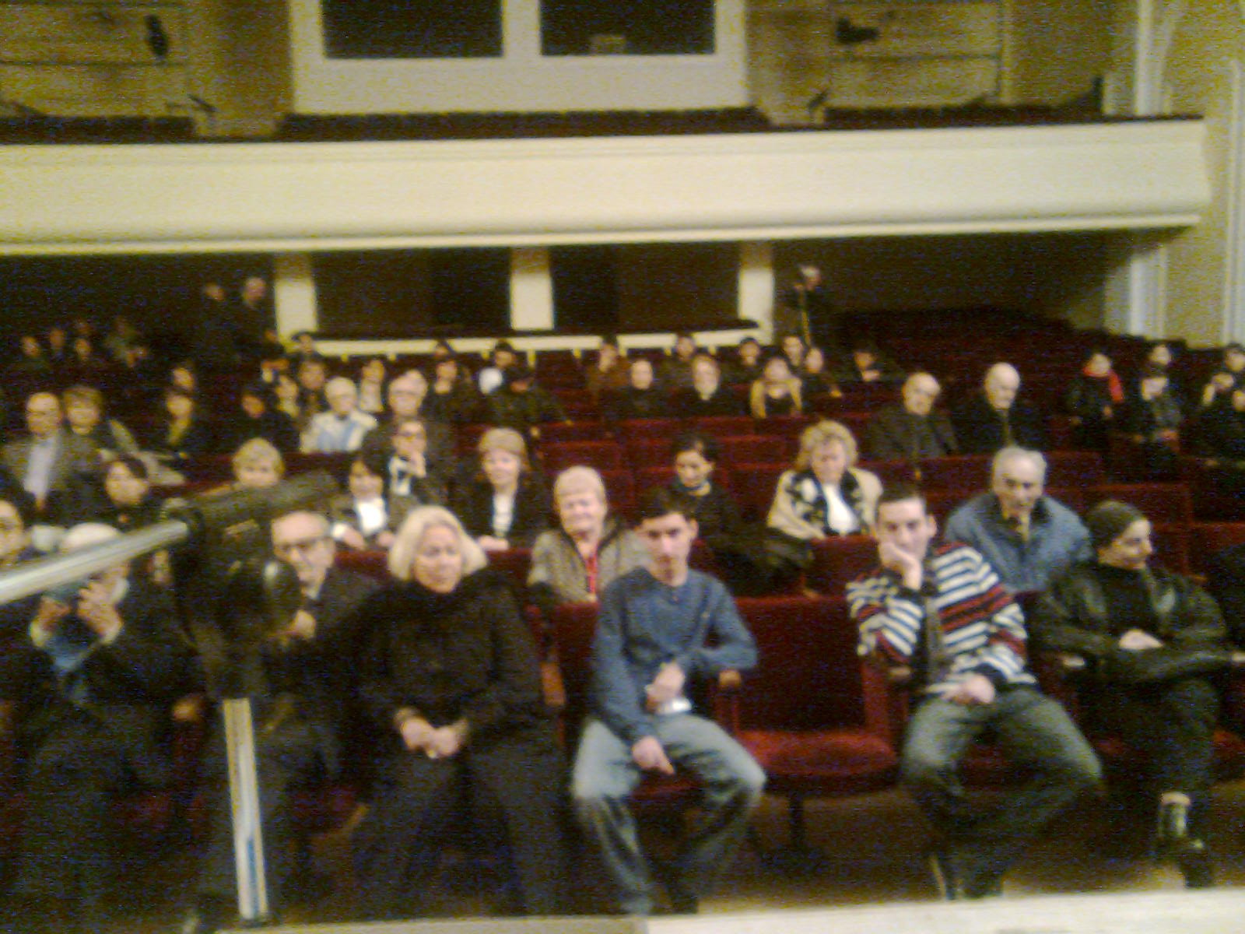

Slide 6
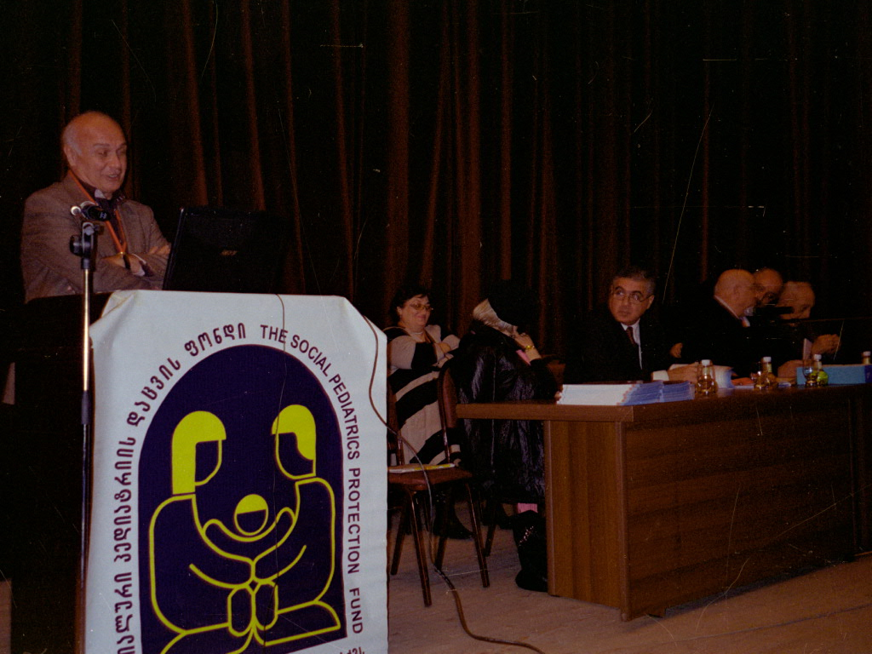

Slide 7
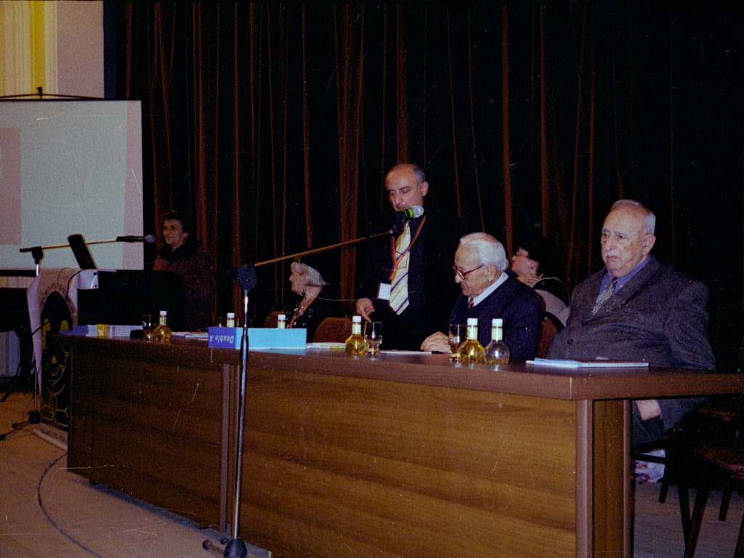

Slide 8
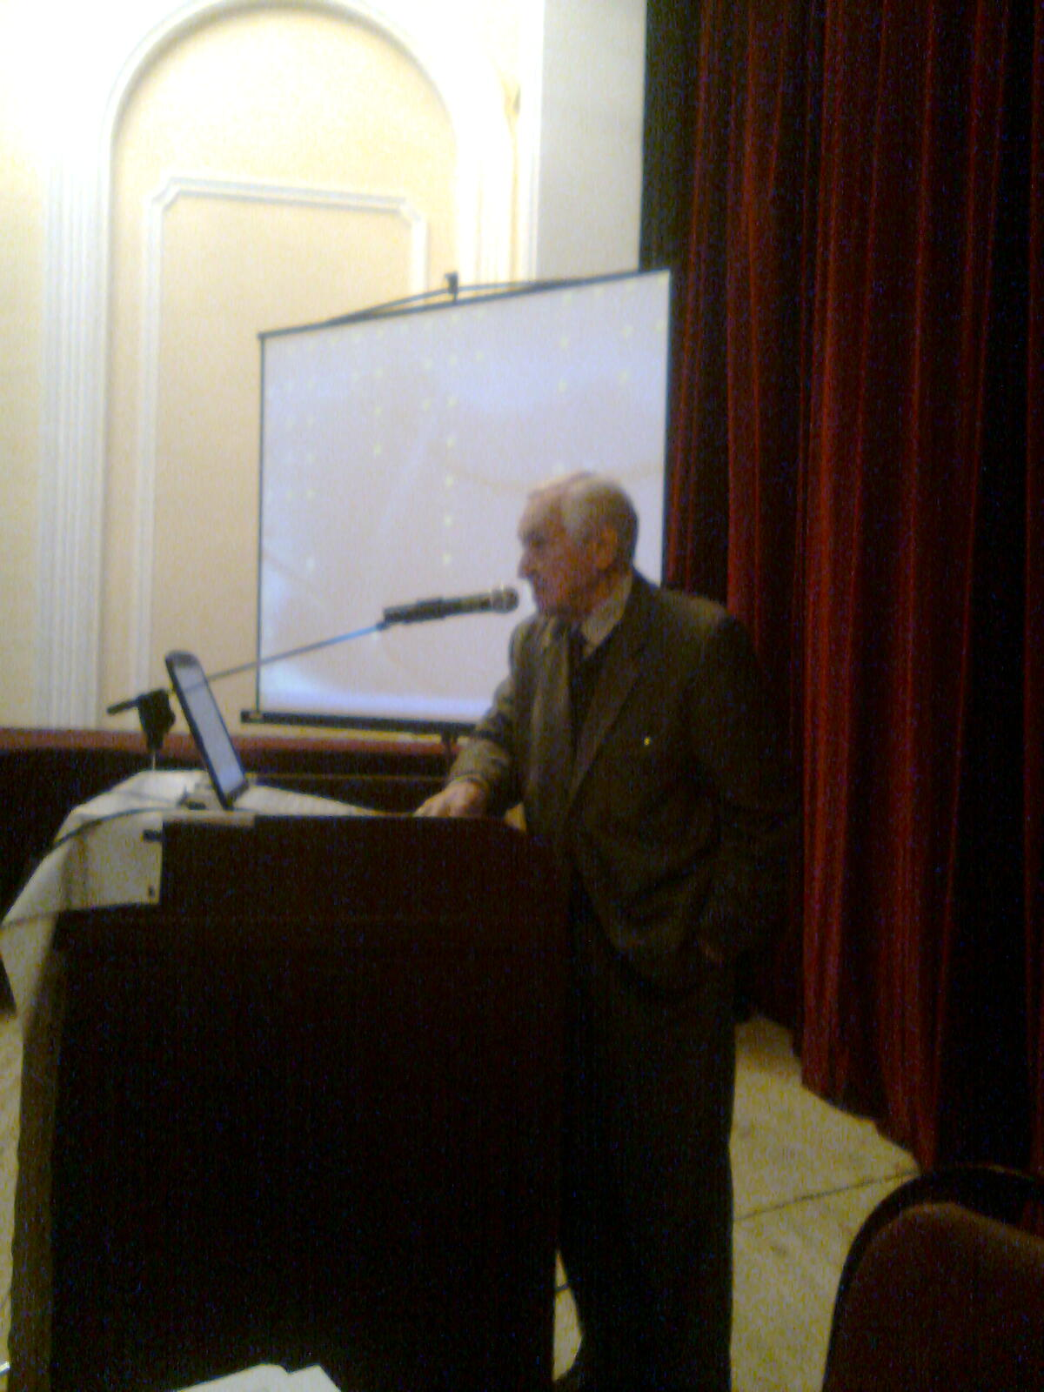
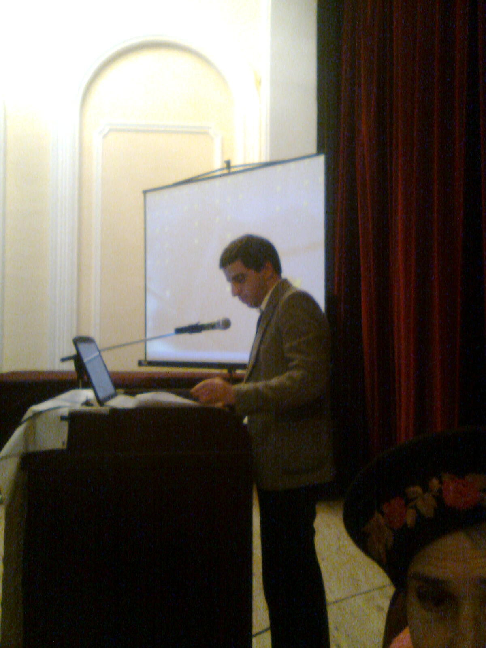

Slide 9
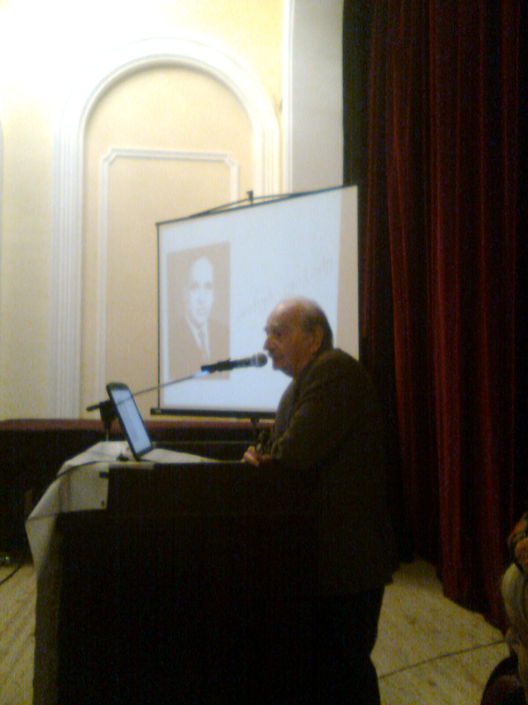

Slide 10
evromecnierebis saqarTvelos erovnuli seqciis medicinis da sportis departamentis samoqmedo strategia – medicinis, sportis da ganaTlebis erTiani marTvis aucilebloba jansaRi Taobis aRzrdaSi – prof. g.CaxunaSvili
2010 wlis 3 dekemberi
Tssu
Tbilisi

Slide 15
The Congress Topics are:
Emergency Management of Field Injuries
Rehabilitation and Management of Sports Injuries
Physical Activity for Health
Training and Performance
Exercise in the Heat
Special Considerations in Women Athletes
Regenerative Medicine in Sport
Sports Nutrition
Paralympic athletes
Doping
. Sports Medicine during International Sports Competitions

Slide 16
saqarTvelos parlamenti
Tbilisi
26. XI. 2010 w.

Slide 17
saqarTvelos parlamentis janmrTelobis dacvisa da socialur sakiTxTa komitetTan arsebuli medikosTa profesiuli asociaciebis samecniero-sakonsultacio sabWos
skolebSi saeqimo kontrolis samecniero-meToduri problemis Semswavleli jgufi:
prof: g. CaxunaSvili _ Tavmjdomare (pediatri)
prof. d. zarnaZe _ moadgile (jand.ogranizacia)
prof. ig. doliZe _ moadgile (sportuli medicina da reabilitacia)
prof. p. kasraZe _ wevri (sportis eqimi)
m. SixaSvili _ wevri ( 9 polik. mT.eqimi)
ir.qarisaniZe _ wevri (ojaxis eqimTa asociacia)
prof. d. tabucaZe _ wevri (pediatri)
med.doq. d. fruiZe _ wevri (saqarTvelos pediatrTa akademia)
prof. r. svaniSvili _ konsultanti
arasamTavrobo organizaciebi:
1 evromecnierebis saqarTvelos erovnuli seqciis medicinisa da sportis departamenti da axalgazrduli klubi.
2 saqarTvelos eqimTa asoviacia
3 socialuri pediatriis dacvis fondi iuridiuli ganyofileba
4 saqarTvelos bavSvTa da mozardTa axalgazrdobis sportis erovnuli federacia.
5 Tbilisis ,,53-e’’ sajaro skola.

Slide 18
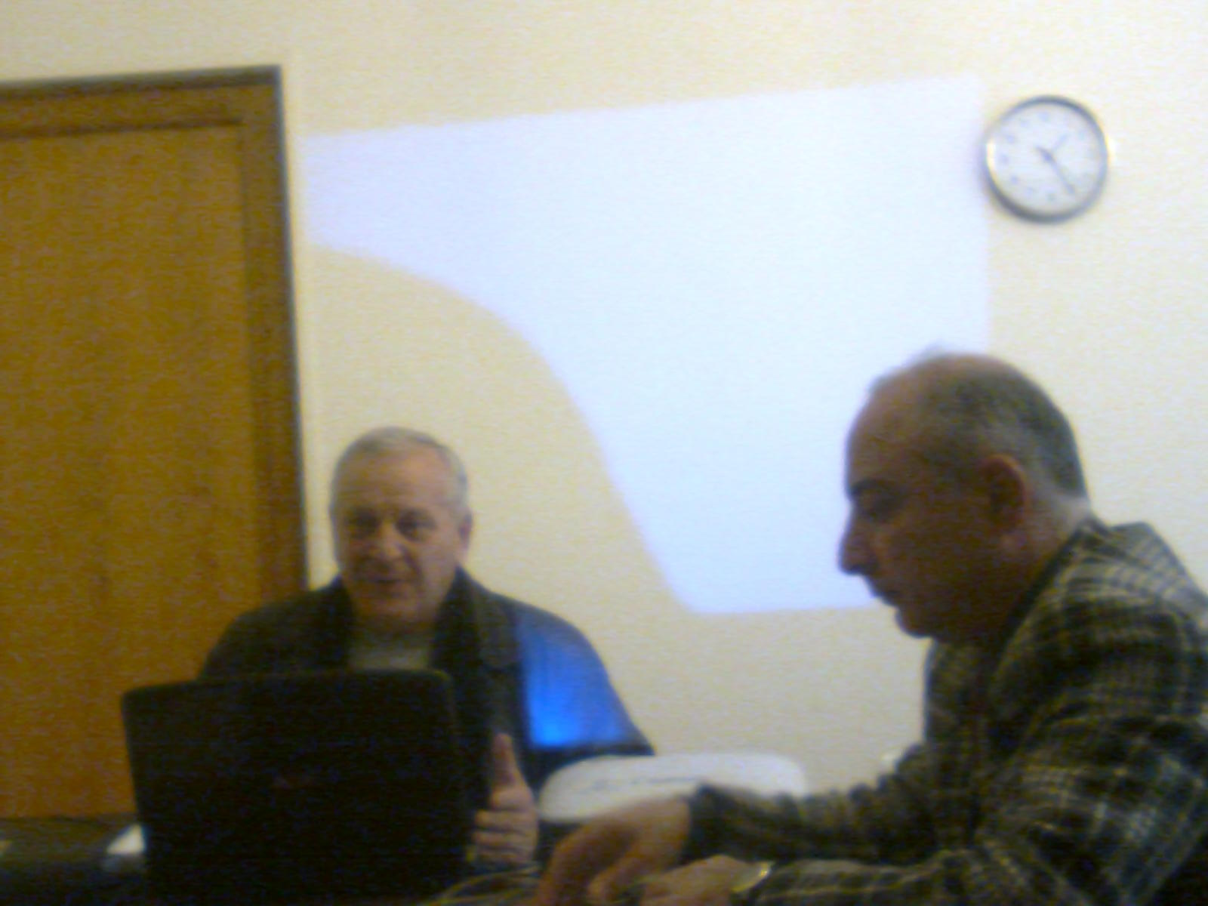

Slide 19
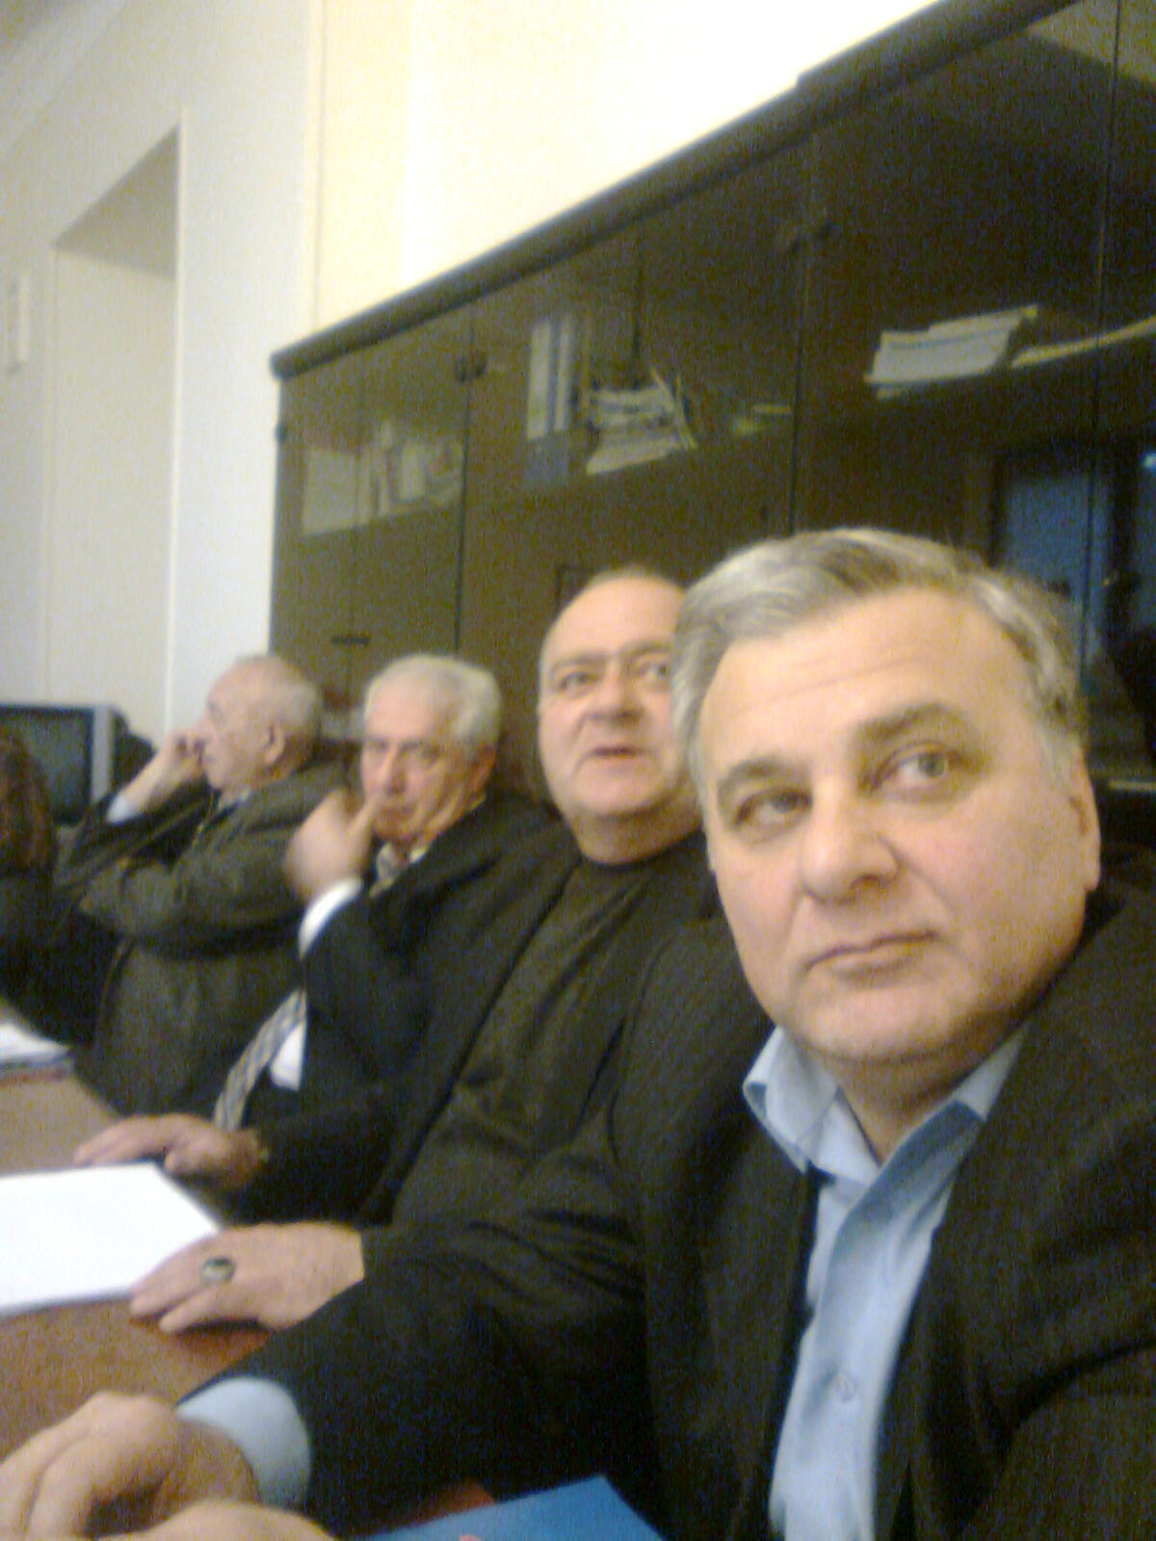

Slide 20
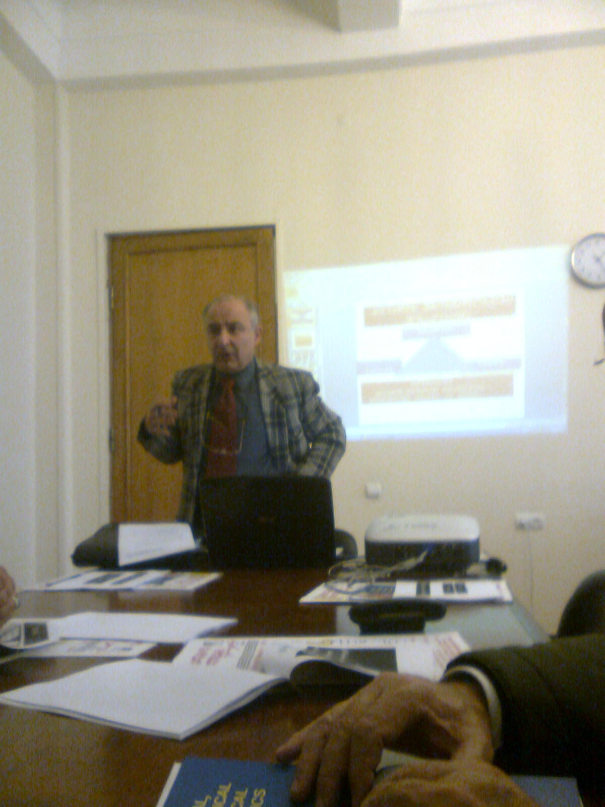

Slide 21
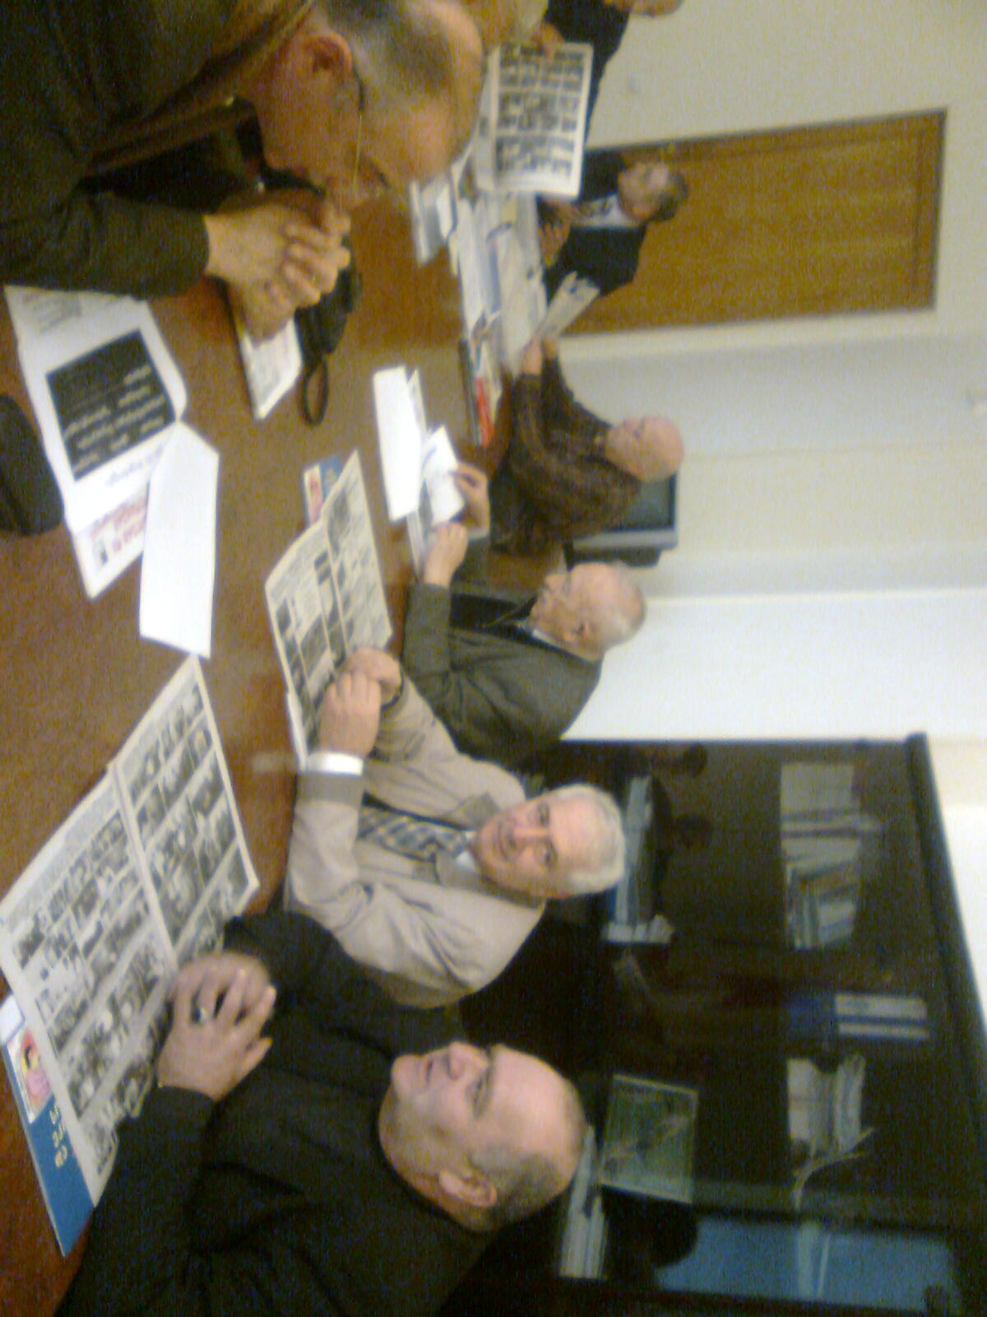

Slide 22
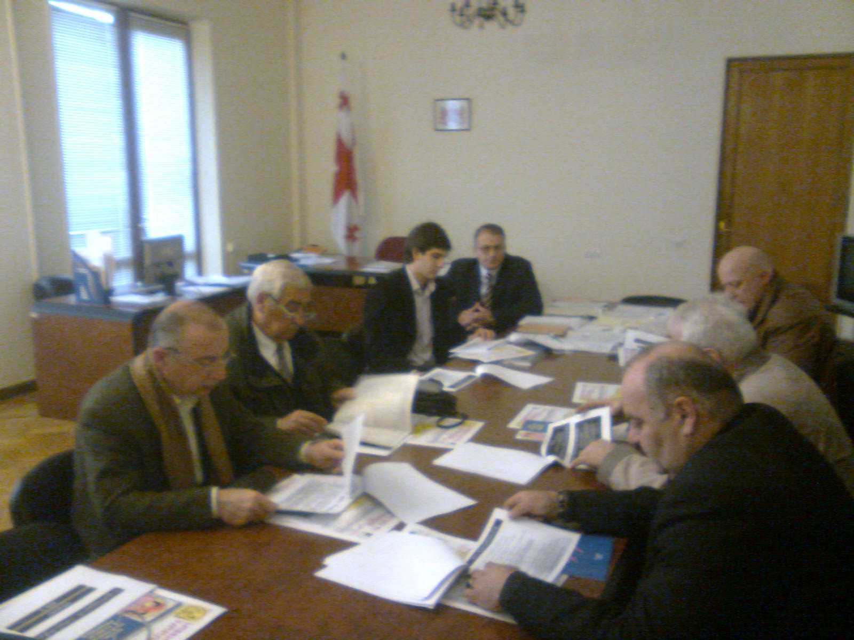

Slide 23
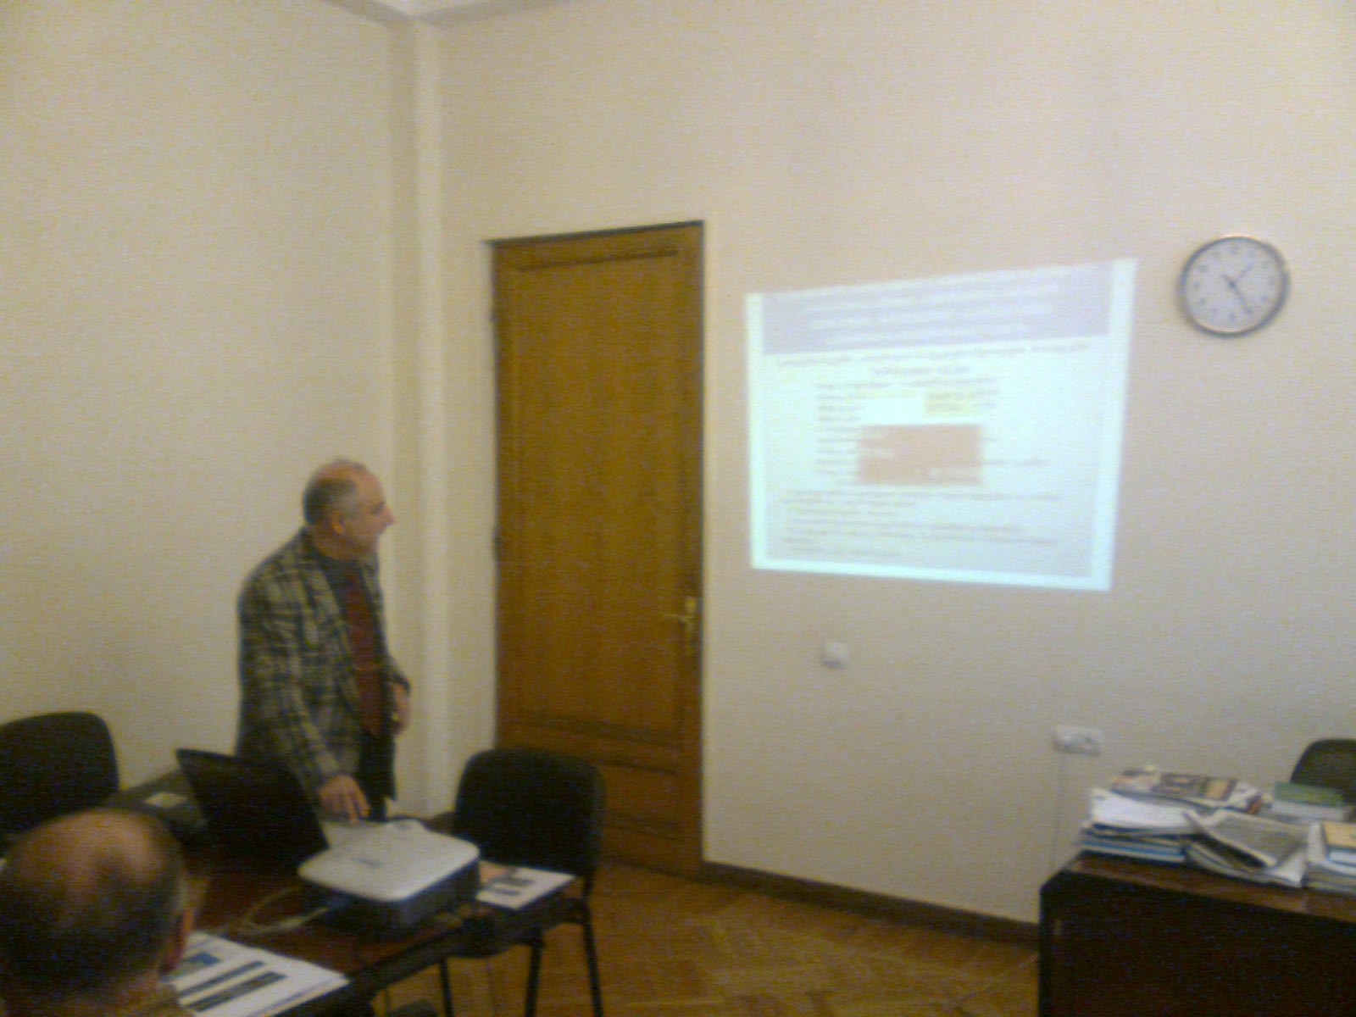

Slide 24
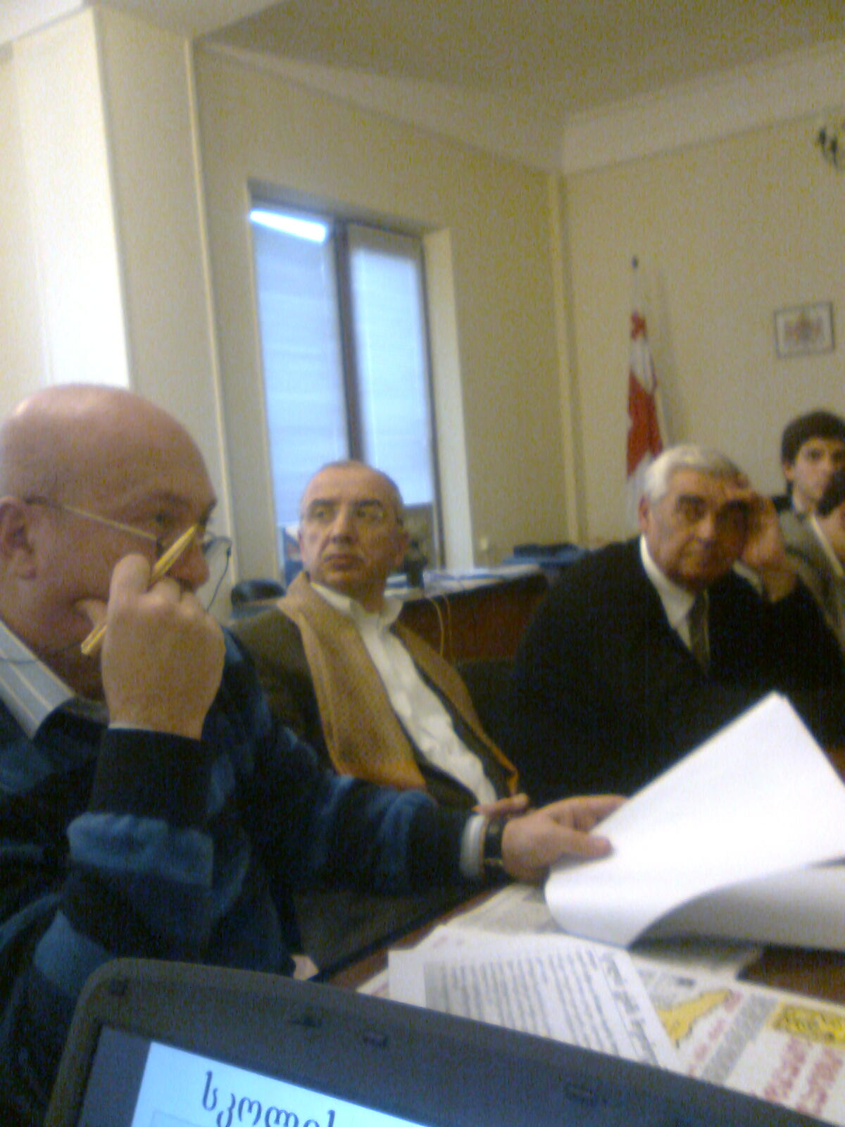

Slide 25
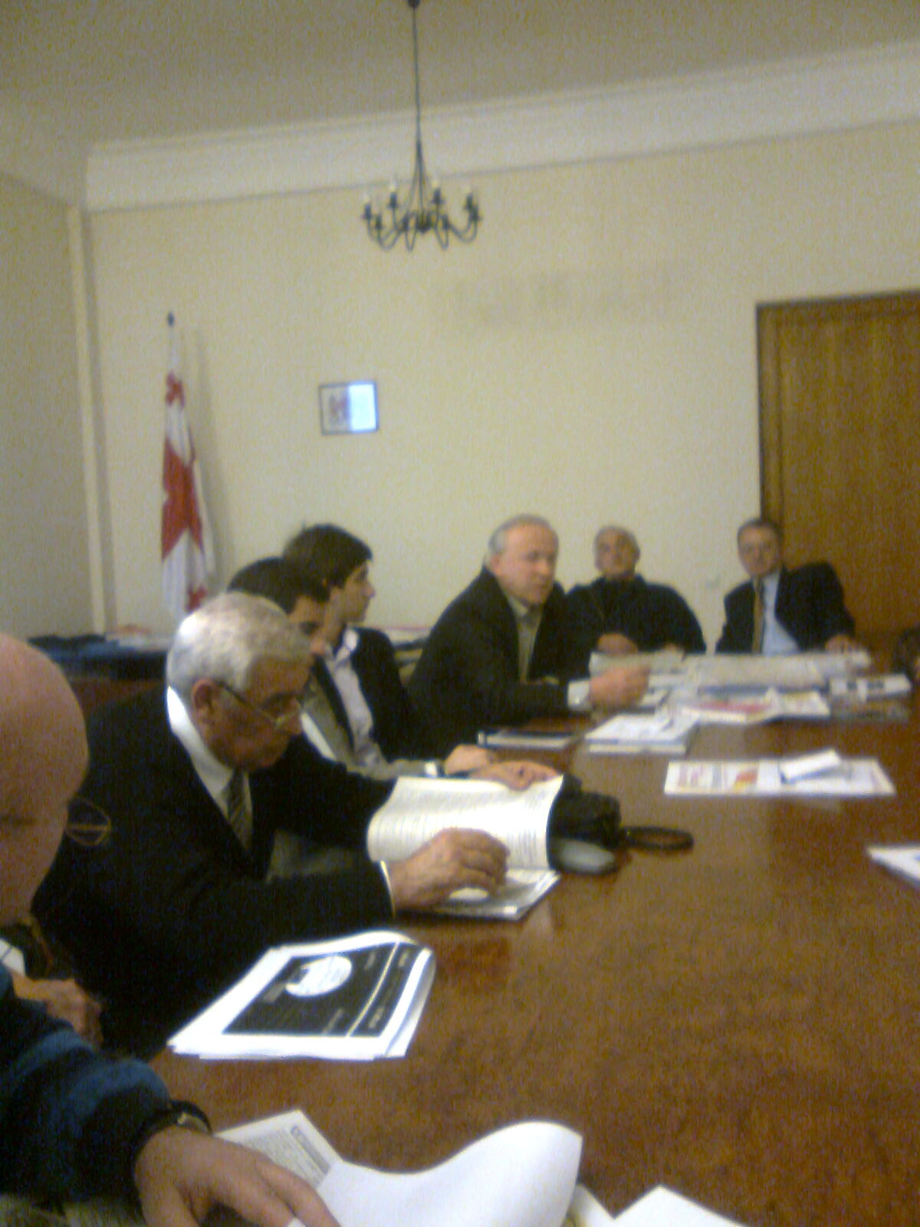

Slide 26
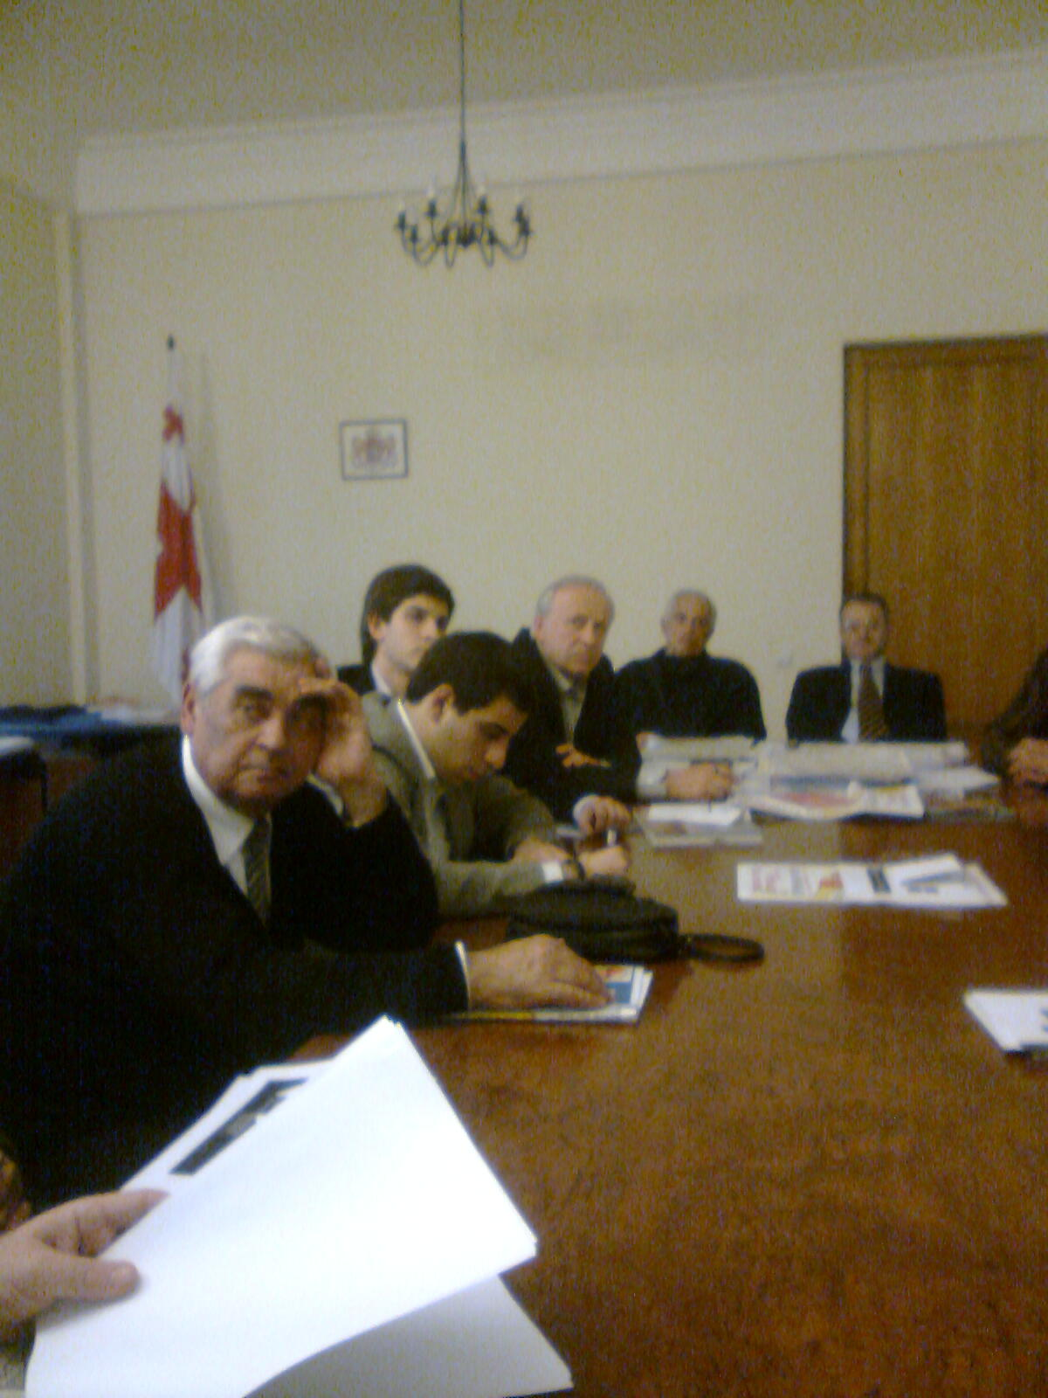

Slide 27
ra uZRvoda win 2010w
saparlamento komitetebis erToblivi RonisZiebani da arasamTabrobo organizaciebTan erTad erTob mniSvnelovan proeqtis miReba
arasamTavrobo da samTavrobo organizaciebis sxvadasxva donis konferenciebi
7-8-9 maisi baTumi
1-2 ivnisi Tbilisi
18 ivnisi Tbilisi
5 agvisto Tbilisi
20 oqtomberi Tbilisi
4 noemberi Tbilisi

Slide 28
ganxilva konferenciebze
7-9, 05,10
01.06.2010.TBILISI /GEORGIA/TSMU
XXII / II

Slide 29
saparlamento komitetebis erToblivi RonisZiebebiT samTavrobo da arasamTabrobo organizaciebTan erTad erTob mniSvnelovan proeqtis
“saqarTveloSi bavSvTa da mozardTa fizikuri ganaTlebisa da sportSi maTi masobrivi Cabmis erTiani erovnuli strategiisa da samoqmedo gegmis SemuSaveba”
aqtiuri ganxilva da misi miReba
18 ivnisi Tbilisi
5 agvisto Tbilisi
20 oqtomberi Tbilisi
4 noemberi Tbilisi
2010 weli

Slide 30
Pproeqtis umniSvnelovanesi monapovaria
ganaTlebis
jandacvis
sportis
saministroTa
proeqtSi erToblivi monawileobis aucileblobis aRiareba da miRweva

Slide 31
aqedan gamomdinare

Slide 32
Jgufis muSaobis arsia: 1.skolaSi saeqimo strategiis Sesrulebis konkretuli winadadebebi 2.debulebebis SemuSaveba saeqimo saqmianobaTa Sesasruleblad
S P O R T
M E D
E D U
specialistebis moTxovnis gansazRvra
-sportis eqimebi
-fizioTerapevtebi
-meTodistebi
Dda a. S.
1.saeqimo kabinetis struqturis gansazRvra
2.gzamkvlevaTa Seqmna
3.specialistTa gadamzadebisa da momzadebis uSuolo Sesruleba
4.saeqimo saqmianobis monitoringi
1.specialistTa gadamzadebisa da momzadebis uSuolo srategiis Seqmna
2skolebsa da baga-baRebSi saeqimo saqmianobis aRdgena
3.proeqtSi erToblivi Cabmis aucileblobiT gamowveuli erTiani mmarTvelobiTi sainiciativo jgufis Seqmna

Slide 33
Uunda SevTanxmdeT,rom
sul sxvadasxvaa da sxvadasxvagvar midgomas moiTxovs:
a)fizaRzrda (baga-baRebsa da skolebSi)
b)sportuli TamaSebi (baga-baRebsa, skolebSi – individualuri, jgufuri, masobrivi)
g)sportuli medicina( aramarto sportsmenebisaTvis)
d)samkurnalo fizkultura da a.S
maT Yyvelas ki sWirdebaT saeqimo kontroli (sxvadasxva saxelmwifoSi igi sxvadasxvagvaria –inglisSi, safrangeTSi, germaniaSi,a.S.S.-Si da a. S)
SemoviRoT axali terminebi prevenciul medicinaSi:
a)bavSvTa da mozardTa fitne(anu samkurnalo da preventuli)vinaidan dResdReobiT didi problemaa adinamia amitom uecari datvirTva sakmao riskia ,romelic Zlier meTvalyureobas da Taviseburebebs moiTxovs.
b)preventuli fizkultura(anu fizaRzrda)

Slide 34
maSasadame, aqedan gamomdinare

Slide 35
skolis eqims moeTxoveba
YYyuradReba
1. skolaSi bavSvTa da mozardTa higienaze zrunva kerZod,
bavSvTa da mozardTa fizikuri ganviTarebis dinamikaze
saswavlo procesis higiena-reJimze kontroli (gakveTilebis raodenoba_xangrZlivoba, dasvenebebi, haeris ganiaveba da a.S.)
kvebis higiena.
dezinfeqciaze, deratizaciaze, dezineqciaze.
sanitarul-teqnikuri normebis dacva (gaTboba, ganaTeba, wyliT momarageba, kanalizacia, ventilacia).
skolis aRWurvilobiT higienuri normebis dacva (merxi, laboratoriuli mowyobilobebi, sport darbazis aRWurviloba da a.S.
skolis saxelmZRvaneloebis higienuri normebis dacva.
SenobaTa adgilmdebareobis higienuri normebis dacva skolebisken.
da sxva higienuri normebis dacva skolaSi.

Slide 36
skolis eqims moeTxoveba
2.sportuli travmebis profilaqtikaze zrunva.
3.sportis sxvadasxva saxeobiT dakavebul bavSvTa da mozardTa efeqturi saeqimo kontrolis warmoeba.
4.yovelgvari I-di samedicino daxmarebis gaweva.
5.bavSvTa da mozardTa daavadebebis profilaqtika.
6..uecari sikvdilis Tavidan acileba ( Q-T intervalis gaxangrZliveba, infeqciur da virusul daavadebaTa Semdgomi ariTmiis gamovlena da a.S.)
7.skolaSi epidreJimze kontroli

Slide 37
eqTans moeTxoveba
1.zogadi eqTnis statusiT gaTvaliswinebuli movaleobebi;
2.damatebiT “fizioTerapevtis” funqciebi.

Slide 38
modeli
saeqimo kabineti
yvela skolaSi
aRWurviloba
eqTani
yvela skolaSi
eqimi
yovel 2000 moswavleze

Slide 39
saqarTveloSi daaxloebiT 2165 zogad saganmanaTleblo skolaa
I etapi _ saeqimo kabinetis mowyoba
_ zogadi profilis eqTnebis daniSvna - 1 weli
_ skolis eqimebis gadamzadeba
II etapi _ skolis eqimebis daniSvnebis dawyeba
_ skolis eqTnebis gadamzadebis dawyeba damatebiT -1weli
_ skolis eqTnebis fizioTerapiis kuTxiT
gadamzadebis gagrZeleba
III etapi _ skolaTa kompleqsis dasruleba -1 weli

Slide 40
I etapi II etapi
skola baga-baRebi
mandaturebi
saswavlo procesi
fizaRzrda
cekva
saeqimo kontroli
* * * * *
datvirTvaze

Slide 41
Aamdenad, skolebSi am etapze /SemdgomSi ki baga-baRebSi/
saeqimo saqmianobis amoqmedeba,
saxelmwifoSi ganaTlebis sistemaSi mimdinare warmatebul reformebs kidev metad srulyofilsa da samagaliTos gaxdis

Slide 42
III etapi
kerZo seqtorebi
sportuli kompleqsebi
kerZo seqtorebi
sportuli kompleqsebi
kerZo seqtorebi
sportuli kompleqsebSi
kerZo seqtorebSi
aRWurviloba
eqimis kabineti
eqTani
eqimi
,,fizioTerapevti”- meTodisti-fitnes monitoringi
momzadeba
da
gadamzadeba
sportis eqimebis
Dda
fizioTerapevtebis
aucilebeli pedagogiuri muSaoba

Slide 52
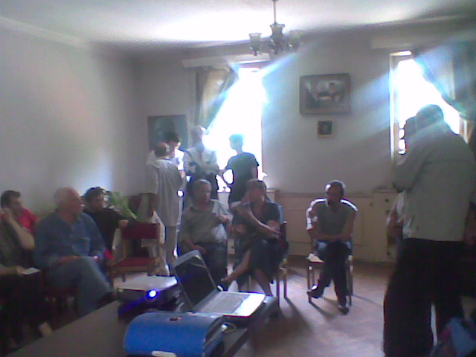
17.05-02.06. daviwQYyeT Sexvedrebi mwvrTnelebTan da sportsmenTa . kKvlevebi erToblivi …konsultaciebiT

Slide 58
E
es Tu ase ar ganxorcielda
ra aris mosalodneli

Slide 59
ganvixiloT oficcialuri monacemebi Tbilisi 4.XI.2010

Slide 60
erT sul mosaxleze bavSvTa saeqimo dawesebulebaSi
mimarTvaTa ricxvi:
2002 weli _ 1.1
2009 weli _ 2.7
aseve, amave periodSi daavadebul wvevandelTa odenoba
gaizarda 21%-iT

Slide 61
 | 2002 weli | 2009 weli
profilaqtikuri gasinjvebi | 699723 | 671213 | _4%
skoliozi | 4329 | 6085 | 30%
tanadobis darRveva | 2629 | 4022 | 35%
smenis daqveiTeba | 879 | 1206 | 27%

Slide 62
 | 2005-2008 weli daavadebianoba |  |  | 2005-2008 weli avadoba
Tvalisa da misi danamatebis daavadeba | 1666.8 | 2273.6 | 27% | 924.6 | 1149.7 | 20%
yurisa da dvrilisebri morCis daavadeba | 984.4 | 1177.7 | 17% | 740.5 | 913.6 | 19%
sunTqvis organoTa daavadeba | 19326.8 | 24512.6 | 21% | 16542.6 | 22568.7 | 27%
saWmlis momnelebeli organoebis daavadebebi | 1978.6 | 3257.2 | 40% | 1376.6 | 2246.6 | 40%
zogierTi parazituli da infeqciuri daavadebebi | 3671.6 | 4013.2 | 9% | 2793.5 | 3339.5 | 17%
fsiqiuri da qceviTi aSlilobebi | 635.5 | 827.2 | 24% | 174.2 | 198.5 | 13%
kanisa da kanqveSa qsovilis daavadebani | 1457.8 | 1742.0 | 17% | 1166.9 | 1391.9 | 16%
Zval-kunTovani sistemisa da SemaerTebeli qsovilis daavadebebi | 332.6 | 614.9 | 46% | 121.5 | 288.8 | 58%
sul | 30054.1 | 38418.4 | 22% | 23840.4 | 32097.6 | 26%

Slide 63
Mminimum riskis jgufis bavSvebis mateba

Slide 64
Uuecari sikvdilianoba !

Slide 65
sportsmen bavSvTa da mozardTa gul-sisxlZarRvTa sistemis Tanamedrove marTva prof. g.CaxunaSvili med. doqtori n.jobava
03.12.2010

Slide 66
Information on the diagnosis, symptoms, genetic implications and treatment of the following conditions:
Conditions that can cause young sudden cardiac death

Slide 67
1Hypertrophic Cardiomyopathy (HCM)
2. Arrhythmogenic Right Ventricular Cardiomyopathy (ARVC)
3. Dilated Cardiomyopathy (DCM)
4. Myocarditis
5. Coronary Artery Disease (CAD)
6. Ion Channelopathies
Long QT Syndrome
Brugada Syndrome
Progressive Cardiac Conduction Defect (Lev-Lenegre’s Syndrome)
Idiopathic Ventricular Fibrillation (without Brugada ECG changes)
Catecholaminergic Polymorphic VT
7. Wolff (Wolfe) Parkinson White Syndrome (WPW)
8. Coronary Artery Anomalies (CAAs)
9. Marfan Syndrome
10. Restrictive Cardiomyopathy (RCM)
11. Endocardial Fibroelastosis (EFE)
12. Tachycardia
13. Antibiotic Prophylaxis
14. Churg-Strauss Syndrome
15. Right Bundle Branch Block (RBBB)
16. Kawasaki Disease

Slide 68
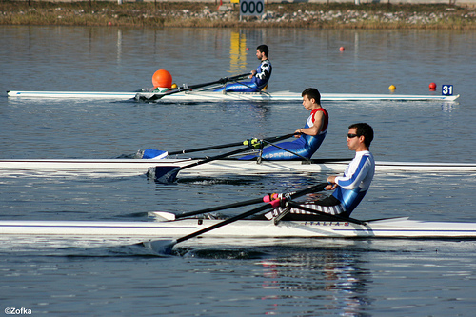
Use of BNP in Athlete Heart Pathology Screening
01.06.10.-XXII////-II
ILIA NADAREISHVILI - AIETI Highest Medical School
GEORGE CHAKHUNASHVILI MD, PhD- TSMU Pediatric Clinic Director Substitute

Slide 69
Aaqedan gamomdinare mxari unda davuWiroT

Slide 70
Pproeqtis umniSvnelovaness monapovars
ganaTlebis
jandacvis
sportis
saministroTa
proeqtSi erToblivi monawileobis aucileblobis aRiarebis miRwevas

Slide 71
Dda xeli SevuwyoT mis
dinamiur ganviTarebas

Slide 72
rezolucia
3-4 dekemberi, Tssu Tbilisi
2010
3-4 December, TSMU Tbilisi

Slide 73
proeqtis ,,saqarTveloSi bavSvTa da mozardTa fizikuri ganaTlebisa da sportSi maTi masobrivi Cabmis erTiani erovnuli strategiisa da samoqmedo gegmis SemuSaveba” monapovars _ jandacvis, ganaTlebisa da sportis saministrTa proeqtSi erToblivi monawileobis aucileblobis aRiarebisa da misi ganviTarebis aucilebeli mxardaWera.

Slide 74
skolebSi am etapze /SemdgomSi ki baga-baRebSi/ saeqimo saqmianobis amoqmedeba, saxelmwifoSi ganaTlebis sistemaSi mimdinare warmatebul reformebs kidev metad srulyofasa da samagaliTos gaxdis.
amdenad, konferencia mxars uWers mis mZlavr amoqmedebas.

Slide 75
aucilebelia:
a) saeqimo strategiis Sesrulebasa da konkretuli winadadebebis swrafi SemuSaveba,
b) debulebis SemuSaveba saeqimo saqmianobis Sesasruleblad

Slide 76
eTxovos:
- jandacvis saministros:
saeqimo kabinetis struqturis gansazRvra
gzamkvlevTa Seqmna
specialistTa gadamzadebisa da momzadebis uSualo Sesruleba
saeqimo saqmianobis monitoringi
-sportis saministros:
specialistebis moTxovnis gansazRvra
sportis eqimebis
fizioTerapevtebis
meTodistebis da a.S.
-ganaTlebis saministros:
specialistTa gadamzadebisa da momzadebis uSualo strategiis Seqmna.
skolebsa da baga-baRebSi saeqimo saqmianobis aRdgena.

Slide 77
eTxovos saqarTvelos parlamentis Sesabamis komitetebsa da aRmasrulebel organoebs proeqtSi erToblivi Cabmis aucileblobiT gamowveuli erTiani mmarTvelobiTi sainiciativo jgufis Seqmna, romelic bolomde miiyvans rTulad Sesasrulebel saorganizacio saqmianobas

Slide 78
Semdegi etapia:
1. proeqtSi erToblivi Cabmis aucileblobiT gamowveuli erTiani mmarTvelobiTi sainiciativo jgufis Seqmna, romelic ganaxorcielebs da uzrunvelyofs Zalzed rTulad warsamarT saorganizacio saqmianobas
2. strategiis gansaxorcielebeli programebis Seqmna, ganxilva da umokles vadaSi maTi Sesruleba

Slide 79
mosalodneli Sedegi:
janmrTeli Taobebis aRzrdaSi medicinis, sportis da ganaTlebis mecnieruli marTviT jansaRi cxovrebis wesSi organoTa funqciebis maCveneblebis gaumjobeseba da maTi kvalificiuri monitoringi

Slide 80
Aaqtiobis Seneleba
A ar iqneba, arc SeiZleba,
Ddro ar iTmens,
TanamSromlobisaTvis
uRrmesi madloba.
prof. g. CaxunaSvili
2010w.

